Slide 1

HEXACAMP

Slide 2

TEAM MEMBERS
HEXACAMP
Sivasathivel Moorthy
Rahinipriya Ramakrishnan
Gautham balasubramanyam
Sumathy Krishnasamy
Sree Ranjitha
Sai Kumar Manubolu

Slide 3

About the Project:
HEXACAMP
People used to plan their trips when they got long weekends or holidays.
HexaCamp help them out to select particular place to visit.
We will arrange the basic needs like food , tent , camp fire , security.
Tourists can choose the camp grounds based on ratings.

Slide 4

HEXACAMP
Problem Statement
Tourists facing budget estimation problems
Basic needs arrangement
Local guide
Identifying all the tourist places in specific region
Choosing the correct place for destiny
Some times You Arrive at the Campground But It Is Fully Booked

Slide 5
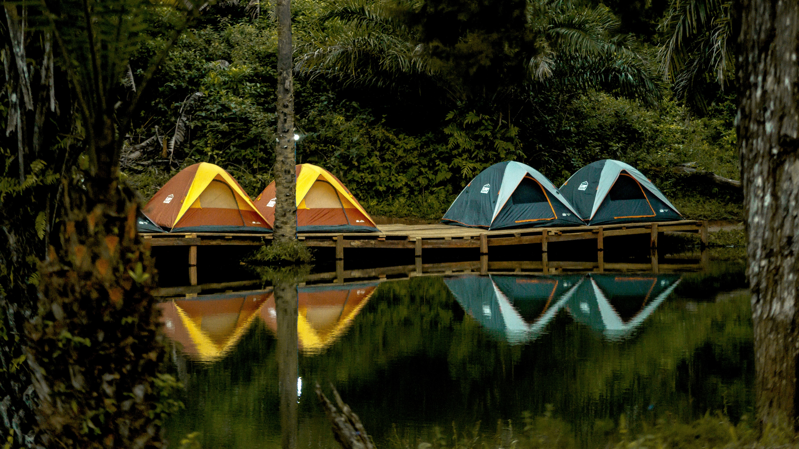
HEXACAMP
In scope:
Admin can able to Add , update and delete Camp grounds.
Users can add camp ground pictures and reviews.
Cluster Mapping concept.
Trip calculator.
Facilities provided by camp ground.
Each camp ground have map location.
Out of scope:
Authentication and authorization
,

Slide 6
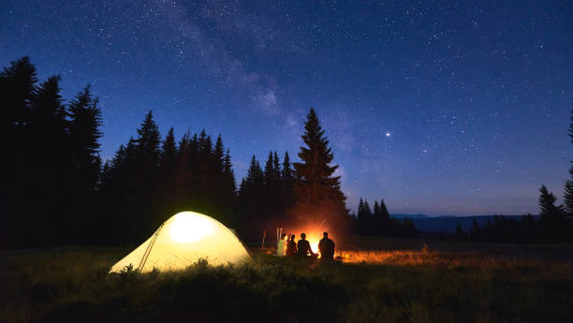
HEXACAMP
Project Entities:
Login
Camp Grounds
Users
Reviews
Id
Title
Description
Price
Images
Email
Mobile
Location
Latitude
longitude
User_Id
Firstname
Lastname
Username
Email
Password
Id
campground_id(foreign key)
Reviews_description
Reviews_rating

Slide 7
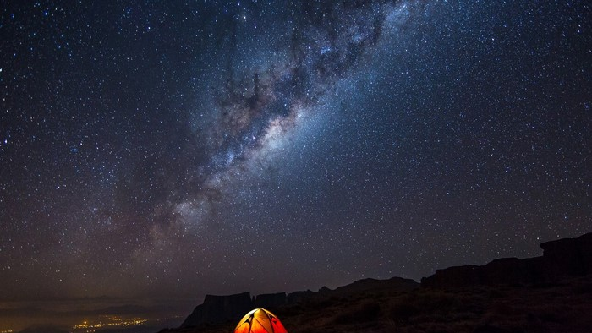
HEXACAMP
Flow
User
Register user
Login
Camp Grounds
Reviews

Slide 8
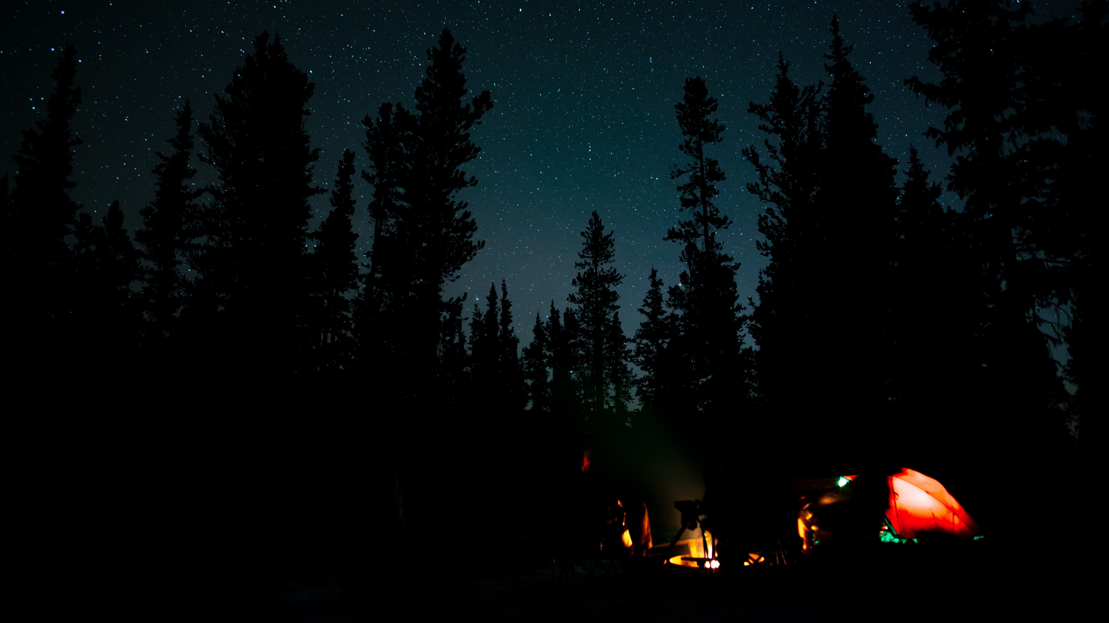
HEXACAMP
ARCHITECTURE:-
MySql
User
HEXACAMP
ADMIN
HTML
CSS
JAVASCRIPT
FLASK
SQLALCHEMY
MAP

Slide 9
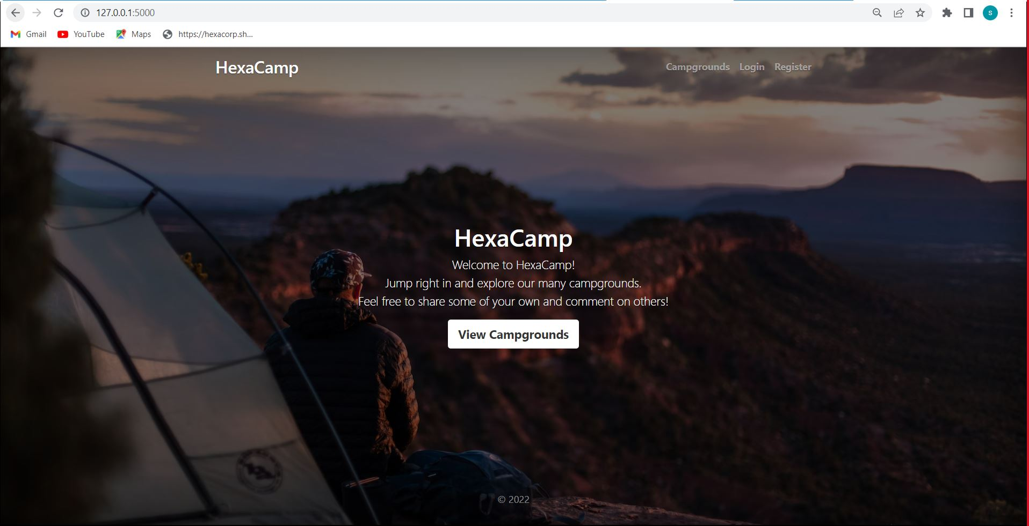

Slide 10
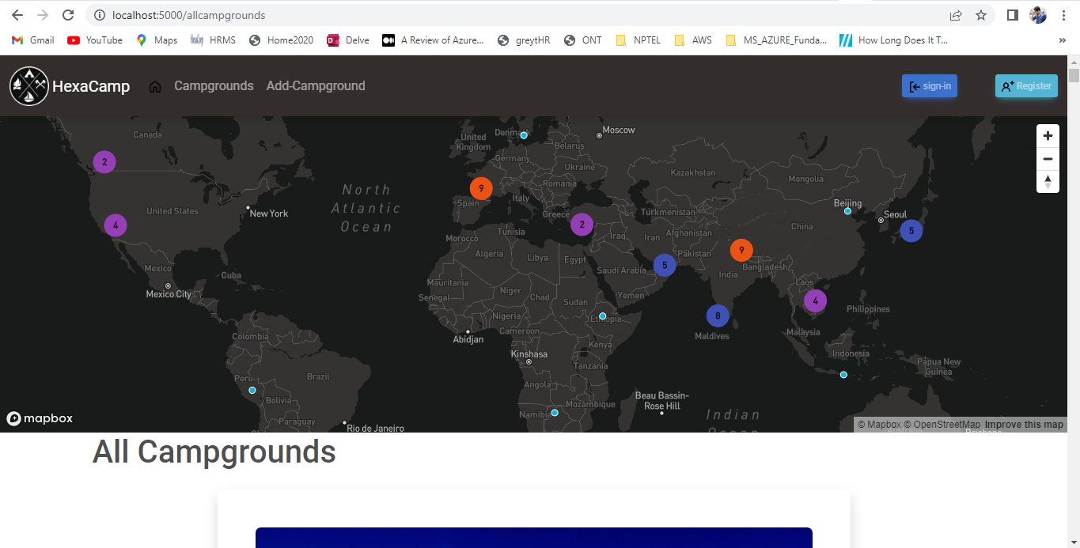

Slide 11
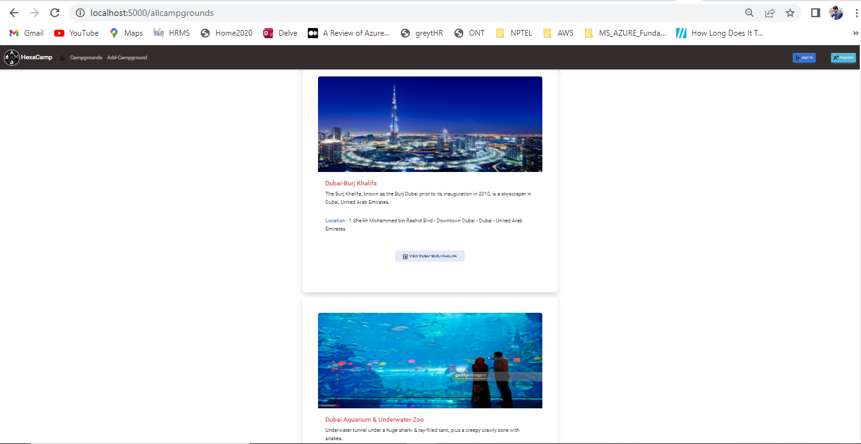

Slide 12
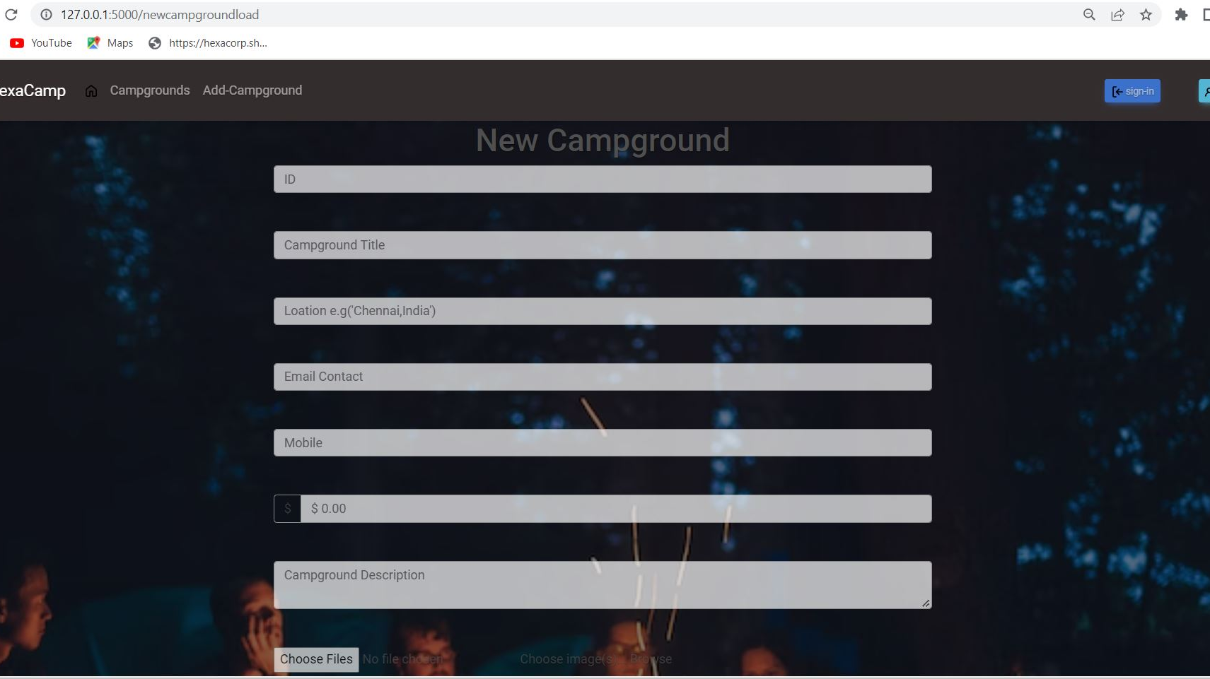

Slide 13
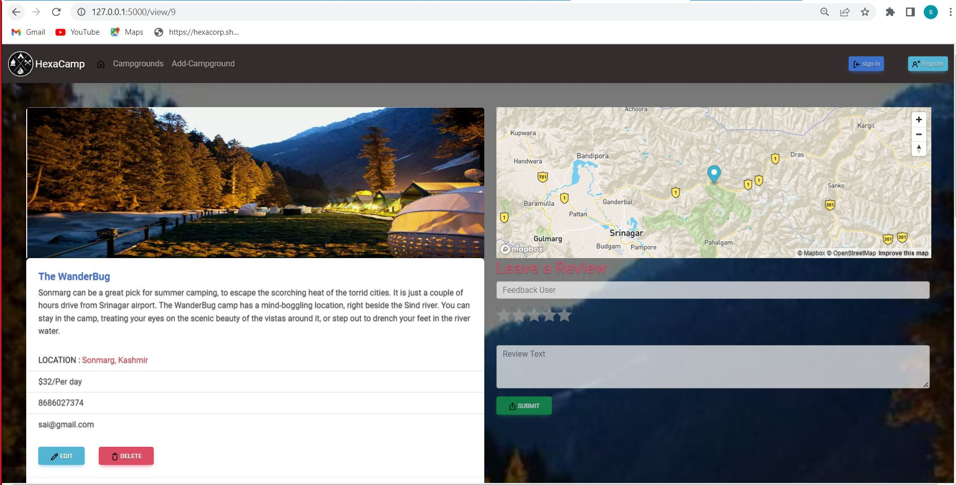

Slide 14
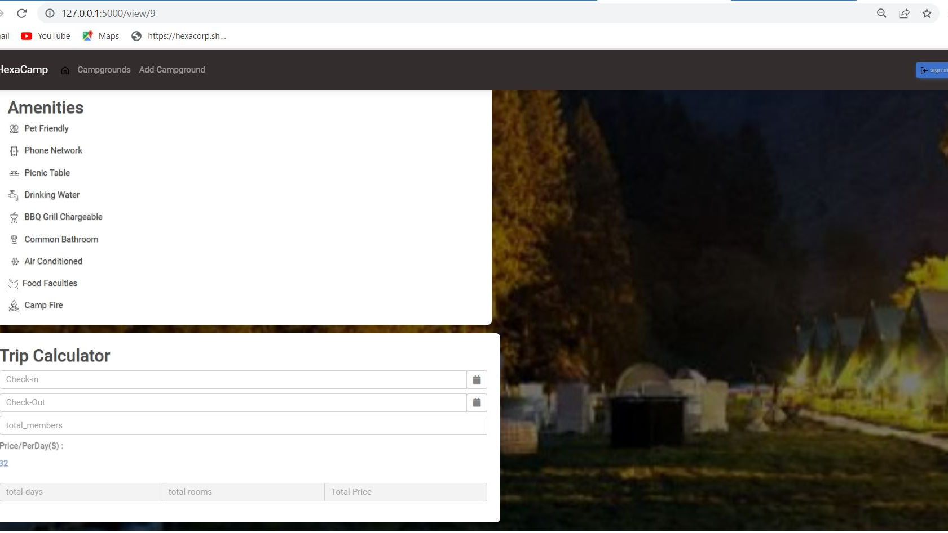

Slide 15
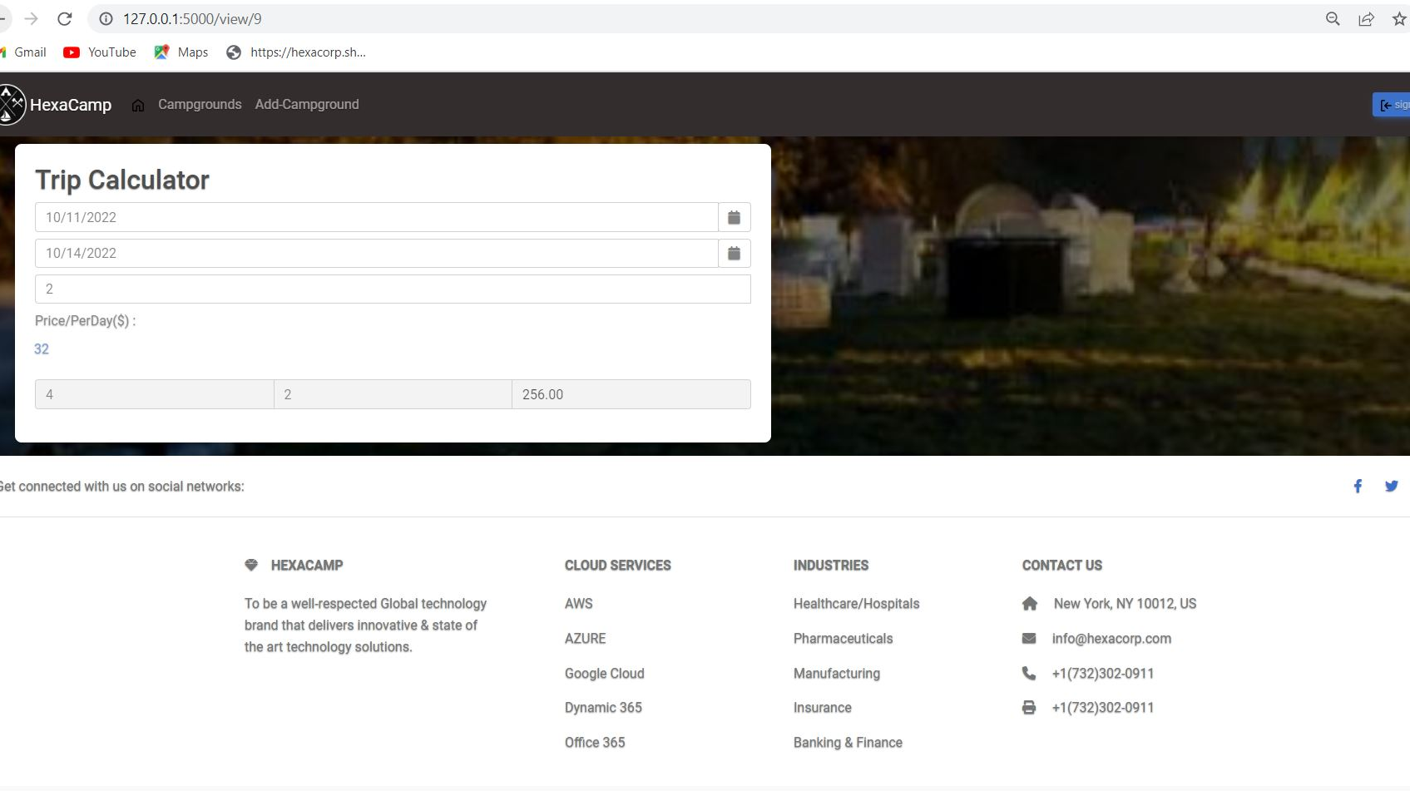

Slide 16
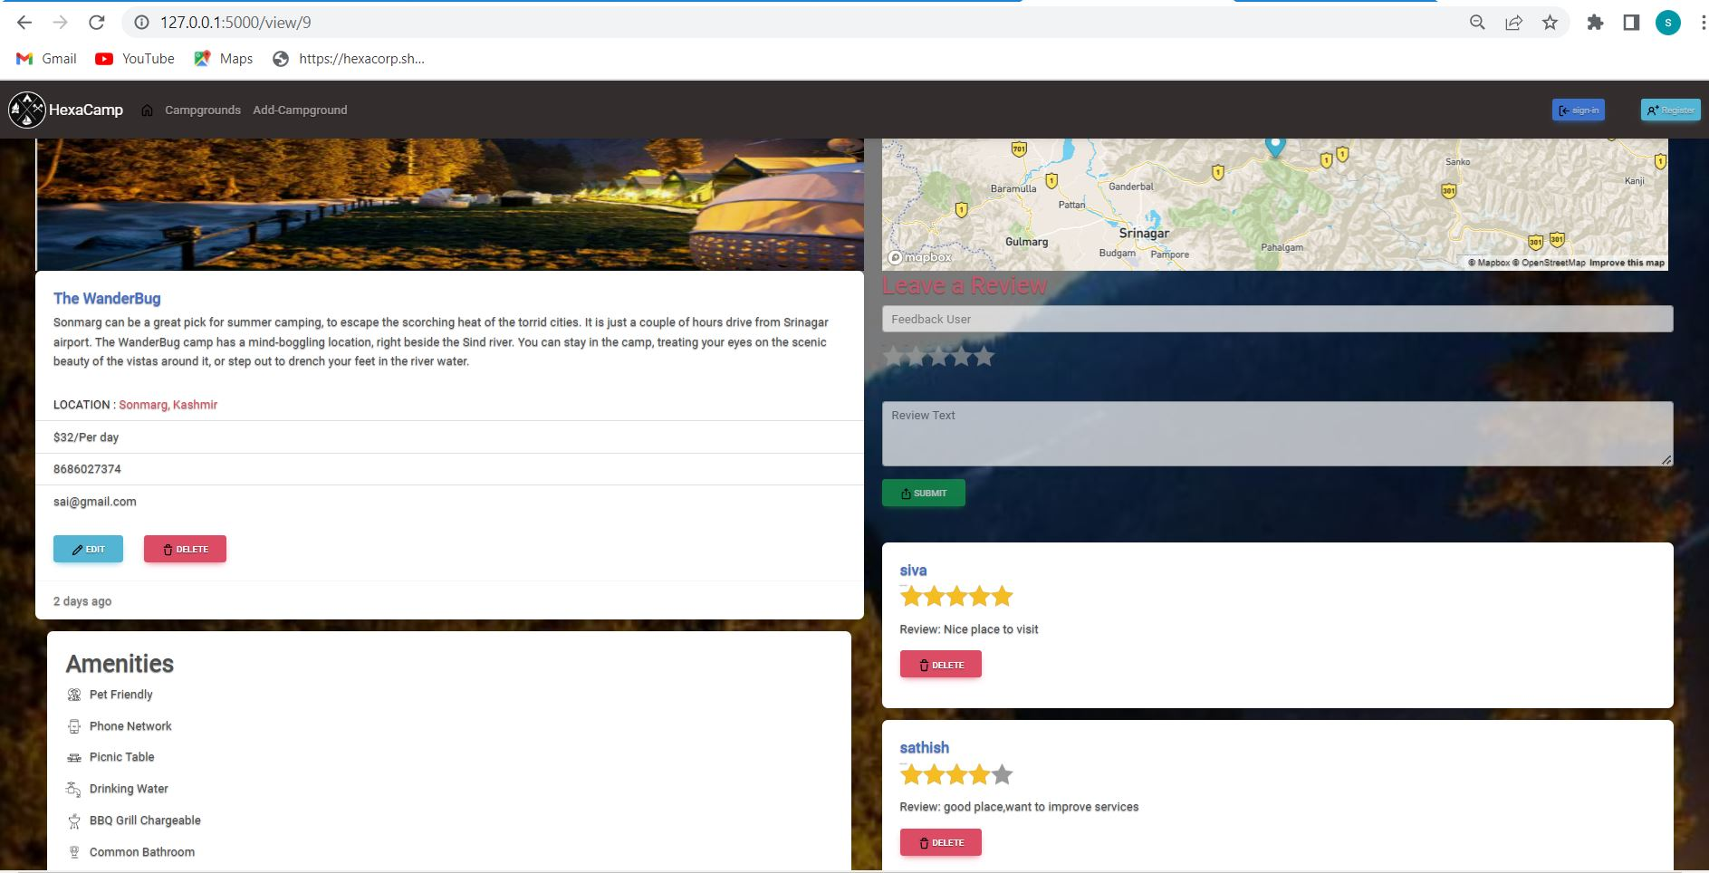

Slide 17

THANK YOU

